Slide 1
Year 11 Mock Preparation

Slide 2
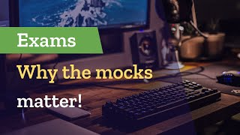
Why Mocks Matter

Slide 3
Why Mocks Matter
1. Mock exams get you in the right mindset
Much like a massive football match or an opening night performance, your exams need to be prepared for and mocks are, the best way for you to do that.
2. Mocks provide an opportunity for structured revision
Helping you to throw yourselves into their exam preparation before it’s too late.
3. Mock exams help you to spot your errors and knowledge gaps
Mocks offer an amazing chance for you to find out exactly where the gaps in your current knowledge are – your strengths, weaknesses and areas that you should target for revision.
4. Mocks ensure you feel prepared in the exam
The chance to become familiar with the process of answering an exam paper and that sense of familiarity can really help to dilute any fears when faced with the real thing.

Slide 7
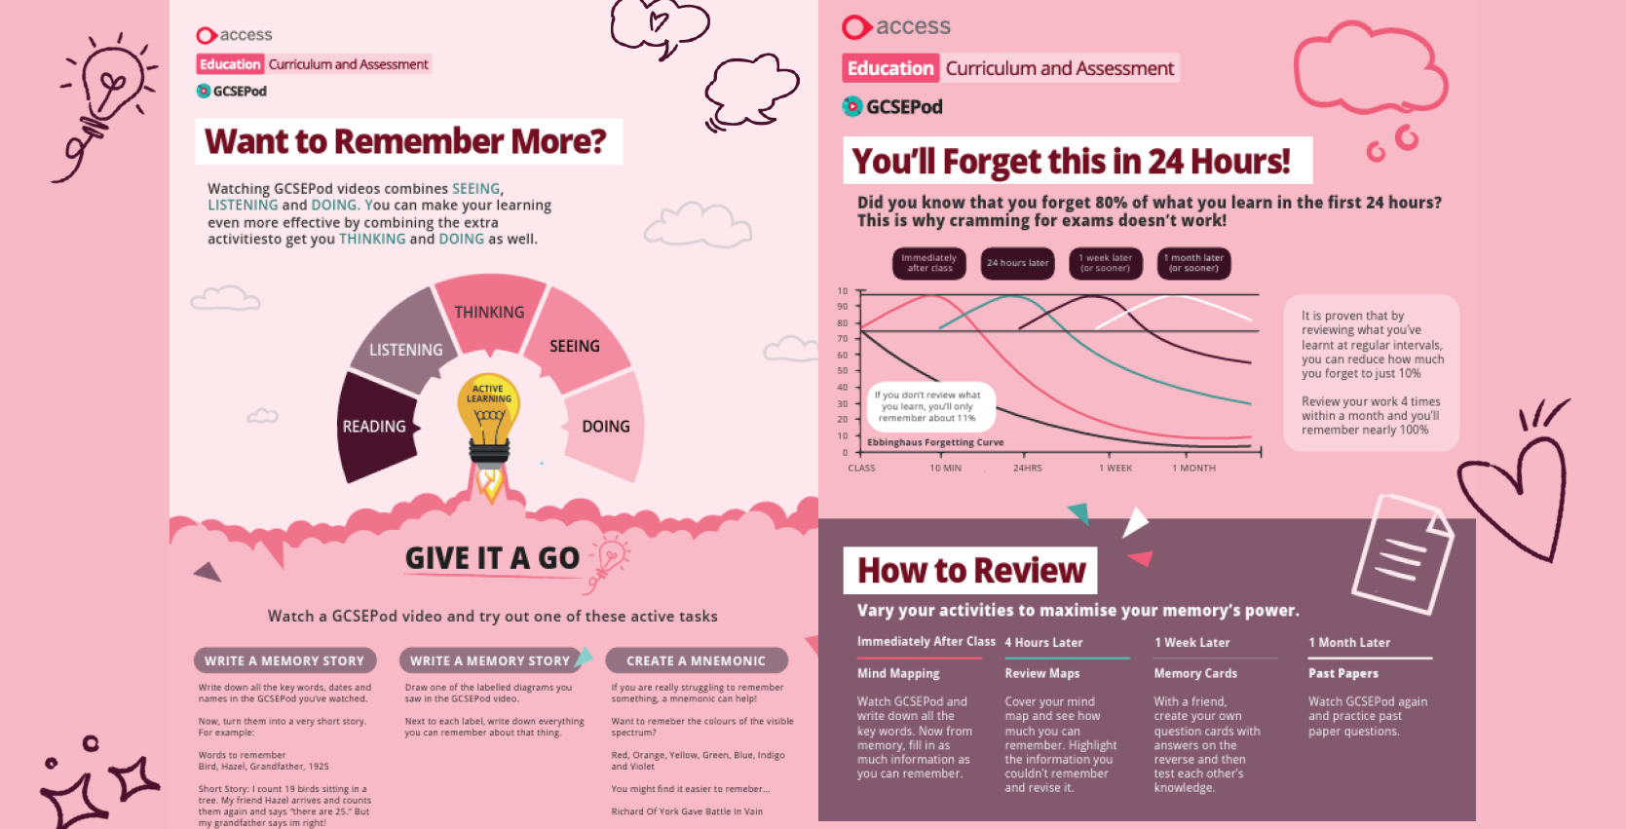

Slide 11
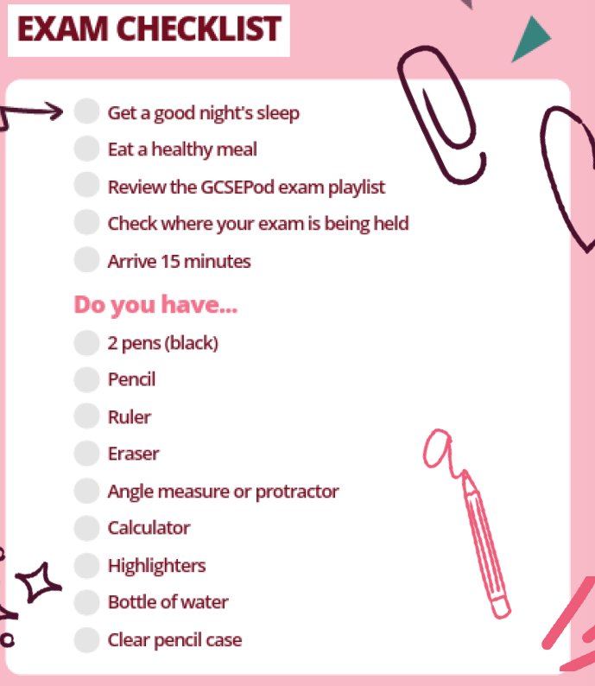

Slide 12
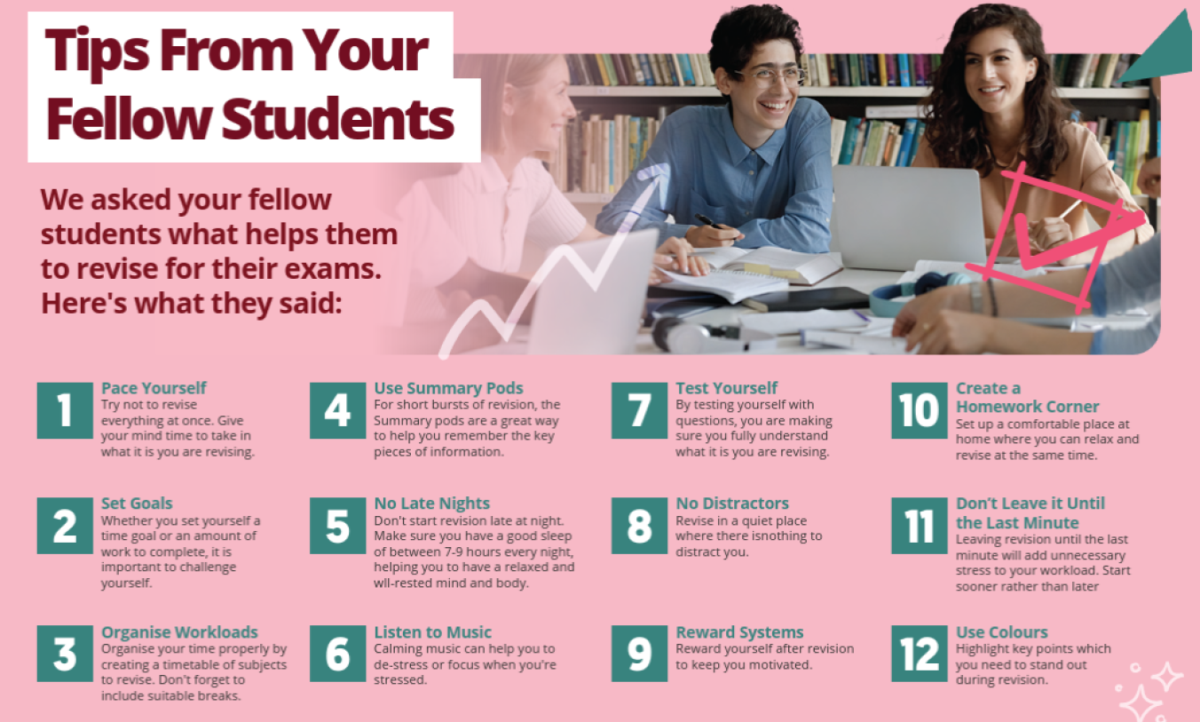

Slide 13
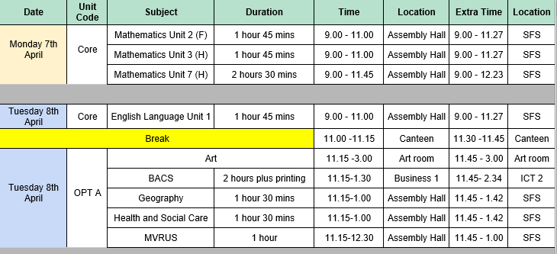

Slide 14
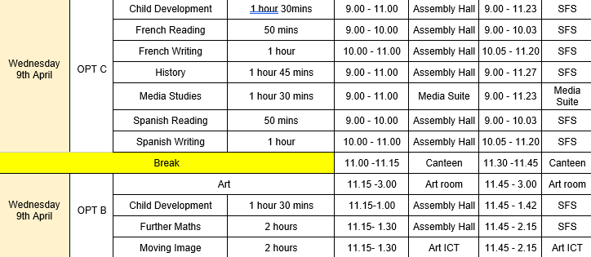

Slide 15
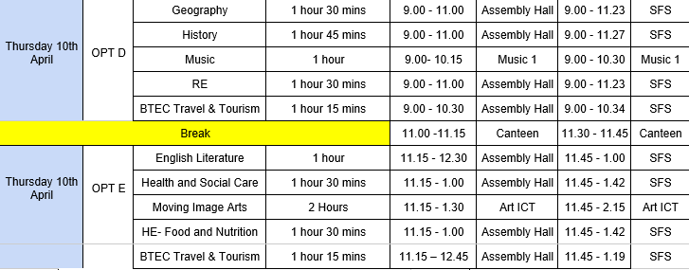

Slide 16
Expectations
Mock exams follow the expectations of the college and of the national exam regulations which you can find outlined below. Misconduct can lead to being disqualified and not receiving a grade.
● Students must remain in silence at all times in the examination hall, and must not attempt to communicate with any other student.
● Students must not carry an electronic device – this includes mobile phones, headphones and watches.
● Students must only have a transparent water bottle and transparent pencil case.
● Once students arrive in the examination hall, students must leave all of their belongings in the designated areas.

Slide 17
We wish you the very best in your upcoming examinations.

